Slide 1
docker

Slide 2
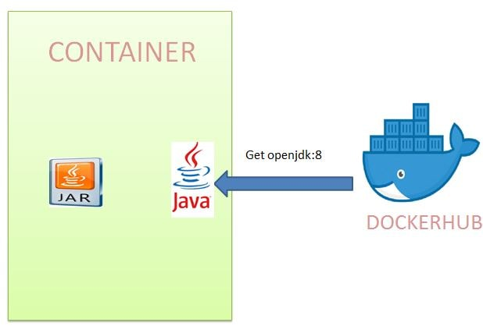
Service with other service as docker containers

Slide 3
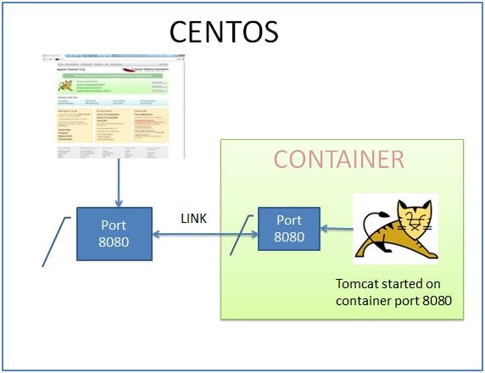
Service with other service

Slide 4
Service with other service

Slide 5
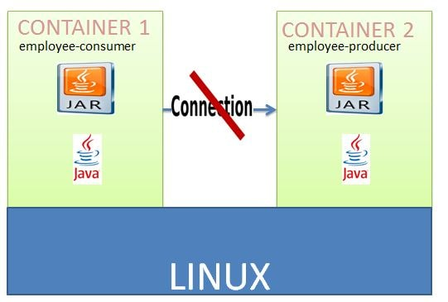
Service with other service

Slide 6
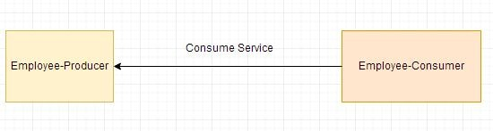
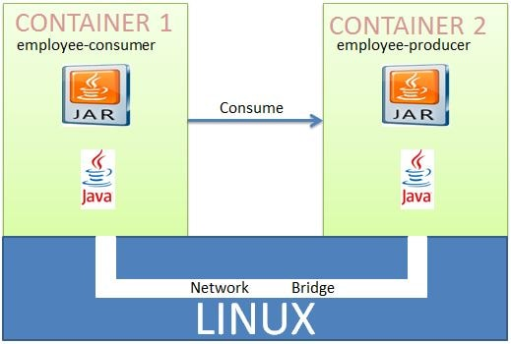
Deploying Multiple Spring Boot Microservices to Docker using Docker Networking

Slide 7
Deploying Multiple Spring Boot Microservices to Docker using Docker Networking
A Docker Container should have only a single service running.
Deploying two microservices employee-producer and employee-consumer to two different containers and then have them interact with each other.

Slide 8
Deploying Multiple Spring Boot Microservices to Docker using Docker Networking
Step-1
Make the employee-producer spring rest boot app.
Package as a jar file using maven build command.
Then Copy this jar file in linux env within a specific folder.
Under this folder , create a Docker file as :
From openjdk:8
copy ./target/employee-producer-0.0.1-SNAPSHOT.jar employee-producer-0.0.1-SNAPSHOT.jar
CMD ["java","-jar","employee-producer-0.0.1-SNAPSHOT.jar"]

Slide 9
Deploying Multiple Spring Boot Microservices to Docker using Docker Networking
Step-1
Open the terminal and start the docker
systemctl start docker
will build an image with the name producer.
docker image build -t employee-producer .
run image as a container named producer. Also publishing the docker port 8080 to centos port 8080.
docker container run --name producer -p 8080:8080 -d employee-producer
test by curl:
curl localhost:8080/employee

Slide 10
Deploying Multiple Spring Boot Microservices to Docker using Docker Networking
Step-2
Create the employee-consumer spring boot app as a client application which call rest services from previous application.
Created and started a container named producer where deployed the employee-producer service. So the only change is while consuming the employee producer service ,using this container named producer instead of localhost:8080. So in the ConsumerControllerClient class use the base url as http://producer:8080/employee instead of http://localhost:8080/employee

Slide 11
Deploying Multiple Spring Boot Microservices to Docker using Docker Networking
Step-2
public class ConsumerControllerClient {
public void getEmployee() throws RestClientException, IOException {
String baseUrl = "http://producer:8080/employee";
RestTemplate restTemplate = new RestTemplate();
ResponseEntity<String> response=null;
try{
response=restTemplate.exchange(baseUrl,HttpMethod.GET, getHeaders(),String.class);
}
catch (Exception ex) {
System.out.println(ex); }
System.out.println(response.getBody());
}
…
}

Slide 12
Deploying Multiple Spring Boot Microservices to Docker using Docker Networking
Step-2
Make jar file using maven build
Copy in linux specific foler .
Make a docker file as :
From openjdk:8
copy ./target/employee-consumer-0.0.1-SNAPSHOT.jar employee-consumer-0.0.1-SNAPSHOT.jar
CMD ["java","-jar","employee-consumer-0.0.1-SNAPSHOT.jar"]
build an image with the name consumer.
docker image build -t employee-consumer .
run the above image as a container named consumer.
docker container run --name consumer -d employee-consumer
check the logs using ------ gets error
docker container logs consumer

Slide 13
Deploying Multiple Spring Boot Microservices to Docker using Docker Networking

Slide 14


Deploying Multiple Spring Boot Microservices to Docker using Docker Networking
Inter Docker Container Communication Using Docker Networking
using Docker Networking to allow multiple containers to interact with each other.
need to create our own network and add both the employee-producer and employee-consumer services to it.
stop and remove the existing docker containers named consumer and producer.

Slide 15
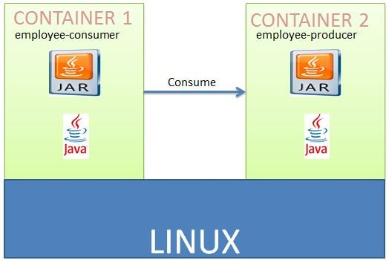
Deploying Multiple Spring Boot Microservices to Docker using Docker Networking
check the available networks
docker network ls
create our own network will be of type bridge
docker network create consumer-producer
start the employee producer container on the newly created network.
docker container run --network consumer-producer --name producer -p 8080:8080 -d employee-producer
start the employee consumer+ container on the newly created network.
docker container run --network consumer-producer --name consumer -d employee-consumer
check the consumer container logs-
docker container logs consumer

